Slide 1

By: Prathamesh Shambhuche.

Slide 2
Agenda:
Introduction
Development History
Architecture.
Working
Advantages
Applications
Conclusion

Slide 3
Introduction
A paper battery is a flexible, ultra-thin energy storage and production device formed by combining carbon nanotubes with a conventional sheet of cellulose-based paper.
A paper battery acts as both a high-energy battery and supercapacitor , combining two components that are separate in traditional electronics.
A paper battery can also be called as the “Bio-Battery”, as they run off of Bodily fluids or other organic compounds.

Slide 4
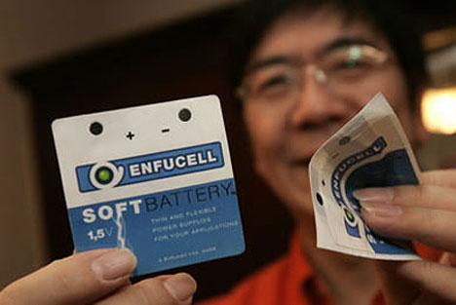

Slide 5
Development History
In August 2007, a research team at Renssealer Polytechnic Institute developed the Paper battery. The team consisted of well known members such as,
Dr. Robert Linhardt, Pulickel M. Ajayan and Omkaram Nalamasu.
The cellulose based spacer is compatible of many possible electrolytes, i.e. Liquid salt as the battery’s electrolyte and also naturally occurring electrolytes such as human sweat, urine and even blood.

Slide 6
Architecture
The Battery is as thin as paper which is made up of 90%Cellulose, by which the traditional paper products are made.
Its coated with carbon ink and the core is layered with 10% of aligned Carbon nanotubes, which give the paper its conductive abilities and also makes it black in appearance.
These nanotubes are Imprinted in the very fabric of the paper which is further termed as Nanocomposite Paper.

Slide 7
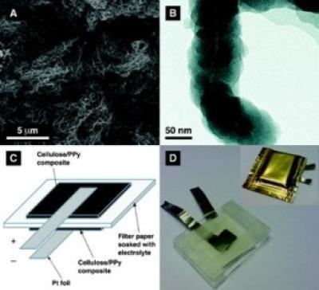

Slide 8
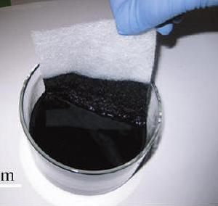
Working
The battery contains carbon nanotubes, each about one millionth of a centimeter thick, which act as an electrode. The nanotubes are embedded in a sheet of paper soaked in ionic liquid electrolytes, which conduct the electricity.

Slide 9
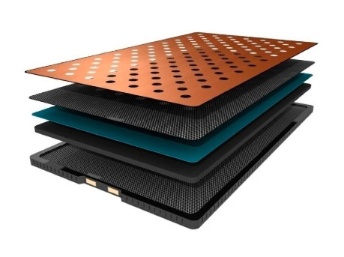

Slide 10
Advantages
Ultra Thin- As the batteries are very thin in size they can be used in any field, which will make the equipment slimmer, faster and compatible.
Completely Flexible- As the is thin in size, it is even flexible and conducts electricity even after being rolled.
Durability- It is an single Integrated device whose carbon components are molecularly attached to each other which is lighter.
As the batteries get ionised by using natural electrolyte from sweat, blood and other organic salt they are ECO-FRIENDLY and easily Degredable.

Slide 11
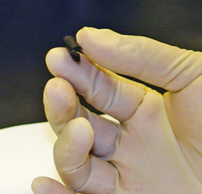

Slide 12
Applications
Medical Applications- Medical implants such as Pacemakers, Artificial hearts or advanced prothetics.
Artificial intelligence- In building high end and high performance Gadgets.
Aircrafts- in making the aircrafts more lighter, more faster and even utilizing a large amount of resource
Automobiles- in development of eco-friendly vehicles and automobiles which will run on electricity generated by Paper Batteries
Toys- In manufacturing safe, smaller, lighter and high performing toys and gadgets.

Slide 13
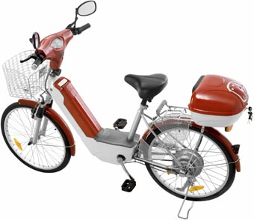

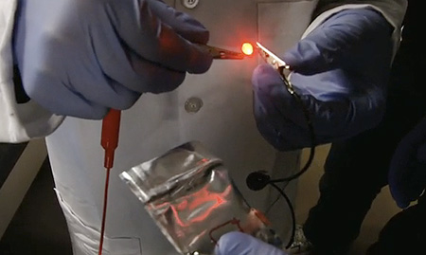

Slide 14
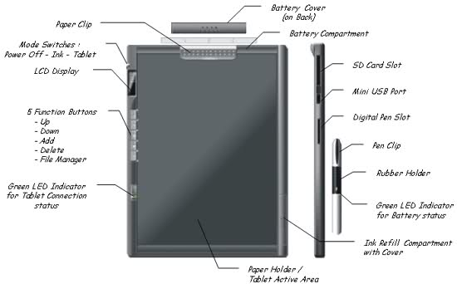
A Tablet PC Prototype with Paper Battery

Slide 15
Conclusion
In today's world of innovation and smart technology adoption is the important aspect that an individual should learn.
Paper batteries are the solution for the electric problems faced by each of us in different fields.
They are eco-friendly, biodegradable and even are more efficient than other alternative sources of electricity.
As the ionic liquid used never evaporates or freezes the Paper batteries can work even in temperatures from 100 degrees Fahrenheit to 300 degrees Fahrenheit.
The power battery can be a boon in the field of technology, science and research. .

Slide 16

Thank You

